Slide 1
Project Management

Slide 2
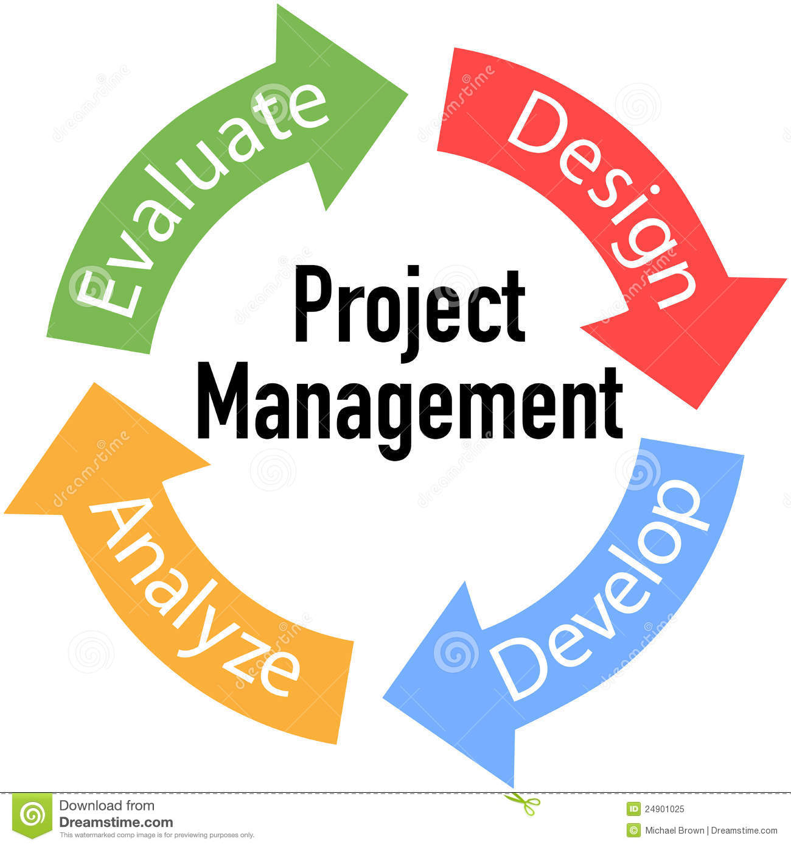
Project Management Cycle
Notes:
Design or PLAN, Develop or DO, Anlayze or REVIEW and Evaluate or DEFINE

Slide 3
Define
1. What are the project requirements?
2. What are the goals of the project?
Gather all important information about the project during this stage.

Slide 4
Plan
Create a schedule
Assign roles
Decide on materials needed
Stay flexible but meet the deadline
Critical!!! The better a project is planned the more likely it is to go smoothly.

Slide 5
Do
Get to work: Build, create, fix
Stay in good communication with teammates
Keep track of your progress by checking with eachother

Slide 6
Review
Occurs once the project is complete
Share results
Reflect on what was learned
Celebrate!

Slide 7
Lego Structure Activity
You have 12 minutes to build a “realistic” structure
You must use ALL of your pieces
Chose 1 person to be the project manager
Notes:
Realistic= someone from outside the group could identify the structure

Slide 8
Project Manager Requirements
Hold onto the bag of Legos
Making sure that everyone is involved in some way
Making sure that there is a plan in place before his or her team begins
Ensuring that all team members understand the goal of the project
Making sure that the deliverable is completed within the specified time

Slide 9
Review
Share your reactions to the project.
What were some of your group’s initial assumptions?
What were some of the resources and constraints of the project?
How did you apply the project management cycle to this activity?
How did it feel to be assigned the role of Project Manager?
How did your Project Manager ensure that everyone was
involved?
Did you need to adjust your initial plan? What kinds of adjustments did you have to make along the way?
Did your group work well together? Explain why or why not.

Slide 10
Homework Due Next Class Period
Plan the Super Bowl
What do you have to do to make this event happen?
Brainstorm ideas for each stage of the project management cycle.
Define, Plan, Do and Review
Work in your Engineer Notebook

