Slide 1
1.2 The Engineer Design Process

Slide 2
What Is Design?
Design challenges are not limited to engineering, but can also be found in other fields.
Artists, architects, interior designers, clothing designers, etc., are all “designing” products and solutions for us! So, they are also engaged in the design process!
So, what is design? Design can be loosely stated as the art of creating something that does not exist. Such a creation can be in the mind, too. For instance, you can “design a story” by thinking about the story plot, the characters you want to use in the tale, how long you want it to be, and who you want to be reading it.
Let’s first consider engineering design, and then you will perform a non-engineering design activity.

Slide 3
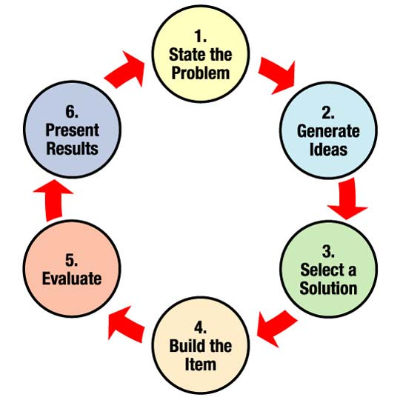
Engineering Design Process
ASEE website states:
“For engineers, the design process is a series of steps that helps teams frame and solve complex problems. Anyone can do it! To figure out how to build something, engineering teams gather information and conduct research to understand the needs and challenges to be addressed.”
⬅So, in a design cycle, the steps indicated in the diagram are done in sequence, and sometimes repeated, too, to improve the design!
See more details on the next slide. ➔
Diagram source: http://teachers.egfi-k12.org/design-process/
Notes:
Diagram source: NASA via ASEE at http://teachers.egfi-k12.org/design-process/
What do I want to do?, What is the problem?, What have others done?
(brainstorm)What could be some solutions? Pick one idea to start with you think would be best
Draw a diagram of your idea. Make a list of materials, Decide how it works or how you will test it.
Build a prototype, test it and talk about what works and what dosent’ work
Talk about how you could improve your product. Draw a new design.

Slide 4
Your 15-Minute Design Challenge:
To design a picnic for your friends.
Brainstorm how you would plan and organize a picnic for your friends. Consider each of the steps in the design cycle and address each one.
Assuming that you organized and held such a picnic, what might be some things you might have missed during planning the first time, and how can you use that to “improve” the picnic the second time?
How is this activity similar to designing a new house or designing spacecraft to take us to the moon?

Slide 5
Example Questions to Answer
Design Challenge: Design a Picnic for Your Friends
Where do you want to hold the picnic? At home, a park, a rented place?
How many friends to invite? Via Facebook, text, email?
What day/time? How much advance notice so you can make sure everyone might has that day open?
What foods and beverages to provide?
What games or activities to plan?
What is your budget? Total all estimated costs on a financial sheet. If costs too much, iterate and revise your plan.
Will the picnic plan be acceptable to your parents/guardians?

