Slide 1
Future City 2016!

Slide 2
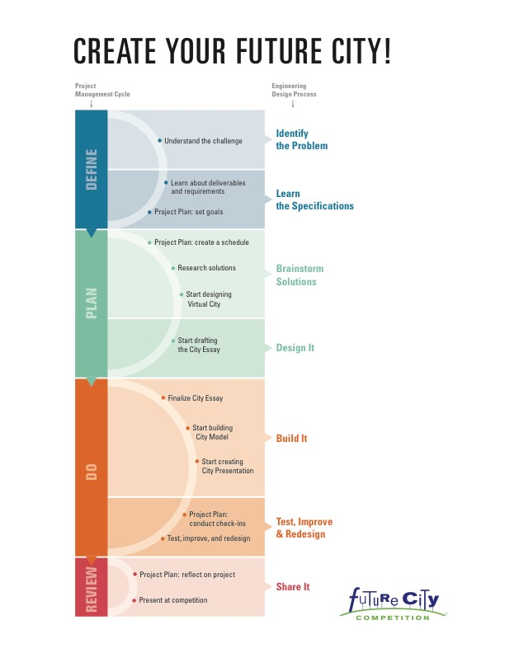
Notes:
You are officially prepared to take on the Future City Challenge. What stage of the engineer design process do we start this project with and what phase of project management? EDP: identify the problem and with Project management: Define

Slide 3
DEFINE: A.) Identify the Problem
1. Understand the challenge

Slide 4
Future City Challenge 2016….

Slide 5
Give your futuristic city a system of…
PUBLIC SPACES

Slide 6
5 Deliverables
Project Plan – help organize your project
Virtual City – design a city using SimCity software and present your city’s progress via a slideshow presentation.
City Essay – describe the unique attributes of your city and share your city’s innovative public spaces.
City Model – build a scale model of your city using recycled materials and incorporate at least one moving part.
City Presentation – present your city to a panel of judges.

Slide 7
Organize into TEAMS….Ready, Set, Go!
Organize your thoughts and questions about the Future City challenge using the KWL graphic.
K: What you KNOW
W: What you WANT to know
L: What you LEARNED
We will discuss questions after 5 minutes of writing. Keep your KWL in your TEAM Binder. Continue to refer to these questions and answers during this project.

